Slide 1
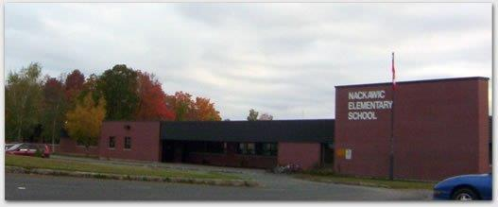
Nackawic Elementary School
Could place school photo here
Presented by Jeanette Garland
Notes:
Good Evening, My name is Jeanette Garland and I am here tonight to discuss Nackawic Elementary School. I am the PSSC Chair at NES and have spent a great deal of time reviewing the information provided by David, talking with the parents of our schools as well as researching into the areas that I felt needed more study, to make the best decision for not only our children but for this town and surrounding areas.
I will begin tonight by thanking the many people who have assisted me along the way in developing this presentation.
I moved back to Nackawic in the spring of 2003 after working with a program in Maine called the Spurwink School which is an accredited non profit organization that provides a broad range of mental health and educational services for children, adolescents, adults and families.
One of the reasons for our decision to return to Nackawic was that my husband and I were going to become foster parents in the province of NB and begin our family. After working in such a program, we knew exactly what was needed and I knew from growing up in the Nackawic school system that we would have those needs met here.
As a parent of 3 and a foster parent of 7 children who had to relocate to our schools for their educational needs while they stayed with us, I know from first hand experience what positive environments our schools are and how well they serve and educate our children.

Slide 2
Voice of our Children
Playground and Fields
Stage and Drama Program with Drama Room
Gym time DAILY for every class with no Double ups
Elementary Activities, Such as Field Trips, Special Speakers and Presenters
Play time with their own age group
Many clubs and activities to do during lunch and after school
Splash Party for all ages at end of year – Grade 5 Farewell
Notes:
I would like to start by talking about some of the great things here that NES has been able to offer….
First off, I would like to take a moment to give a voice to the students @NES. The student council has taken the time to share just a few of the wonderful things they experience here at NES.
Playground and Fields
Stage and Drama Program with Drama Room
Gym time DAILY for every class with no Double ups
Elementary Activities, Such as Field Trips, Special Speakers and Presenters
Play time with their own age group
Many clubs and activities to do during lunch and after school
And of course the Splash Party for all ages at end of year as well as the Grade 5 Farewell
These activities and so many more not named are geared to all age groups and it is feared that these inclusive opportunities would disappear with a reconfiguration.

Slide 3
Student Involvement
DRAMA CLUB
Notes:
Here you can see our kids enjoying one of those activities in the drama club.
The children are able to experience the many sides of drama, utilizing our stage to perform, building their self esteem, exploring their creativity and developing their public performing skills.
We are very proud of their accomplishments.

Slide 4
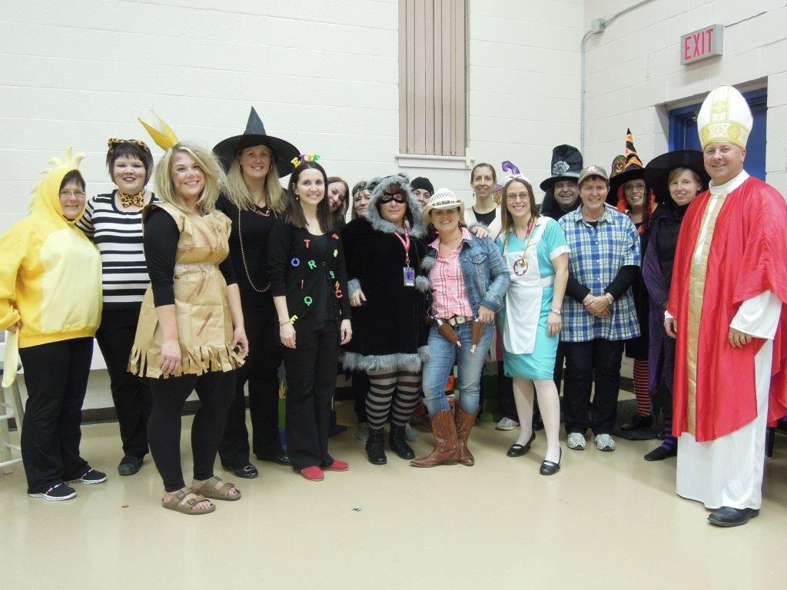
Student Engagement
92% of students reported that they were interested and motivated in their learning.
Canadian Norm – 74%
Notes:
The results from the “TTFM” surveys at NES clearly shows that our students are interested and motivated in their learning. This is due to our staff here at the school who go way beyond their duties to make sure that our children are active and engaged in their educational experience. This picture from the Fall Family Fun Night shows just how far they are willing to go to enliven the educational experience.
In speaking with some newer members of our community, I have heard repeatedly that one of the major draws to this area is the size of our schools and the quality of the teaching and programming. One of the main advantages to living rurally is the ability to have the school size in moderation and also the opportunity for our teachers to know who and where our children come from, while relating to their environment.
As many of you can relate, when our children are happy, we are happy.

Slide 5
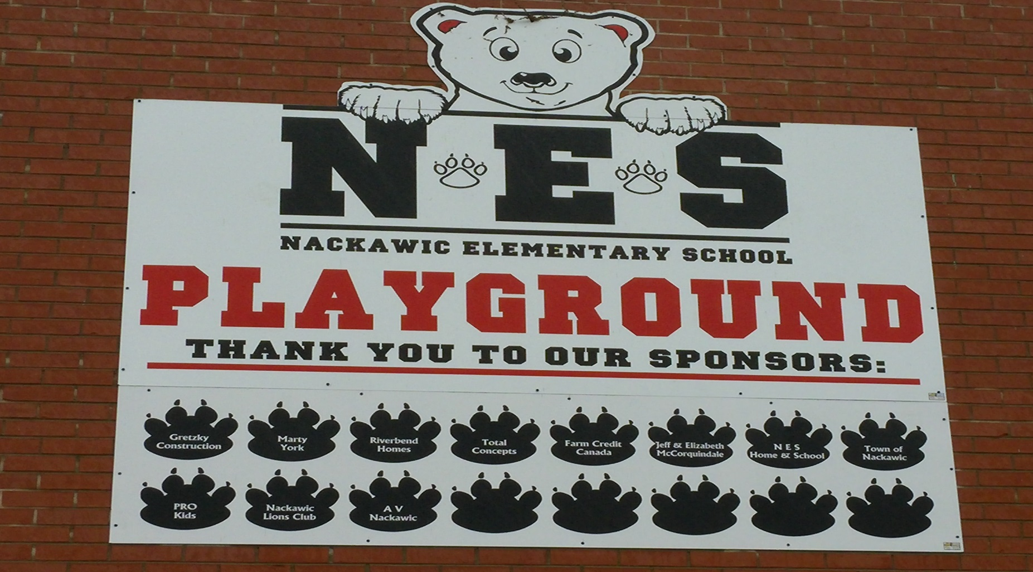
Community Involvement
Notes:
Here I would like to share with you our achievements and goals in our outdoor space that has been created with the support of our community.
We have a dedicated team of volunteers who have worked hard to create a safe playground to encourage social interaction and physical activity.
There is on going work and planning to expand the area of play along with a creative idea for stimulated learning, that would see an eco learning space set along side of our playground in a dense wooded area.
This would allow our children an enhanced learning experience, that would help make connections for our students around environmental issues while in a natural setting.

Slide 6
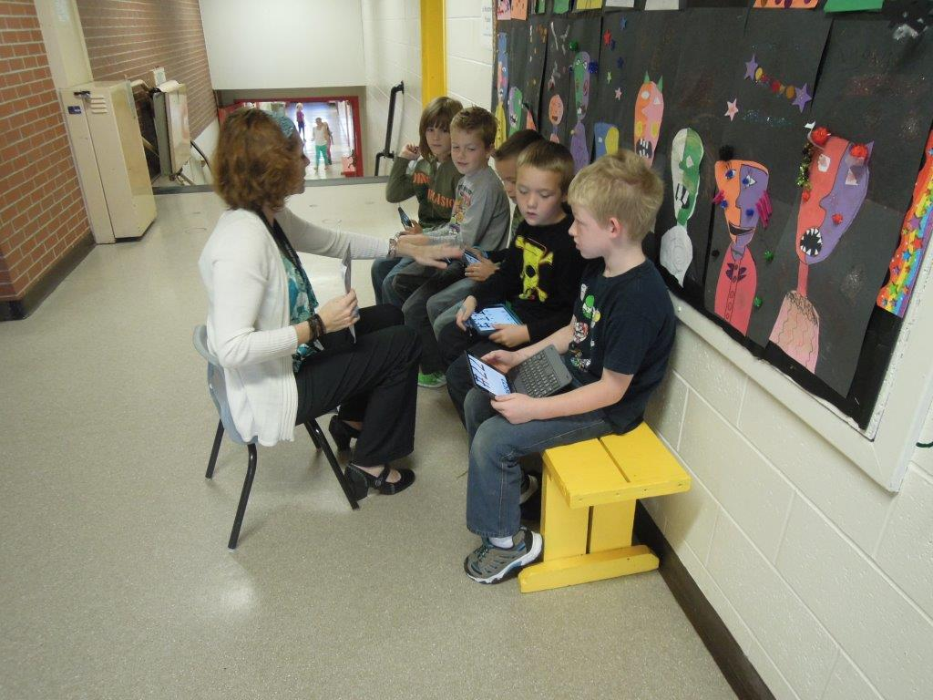
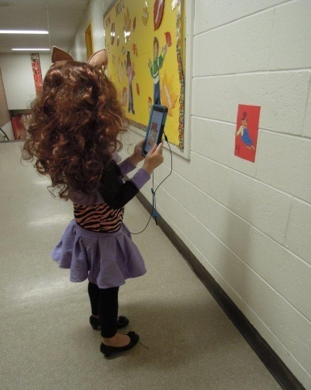
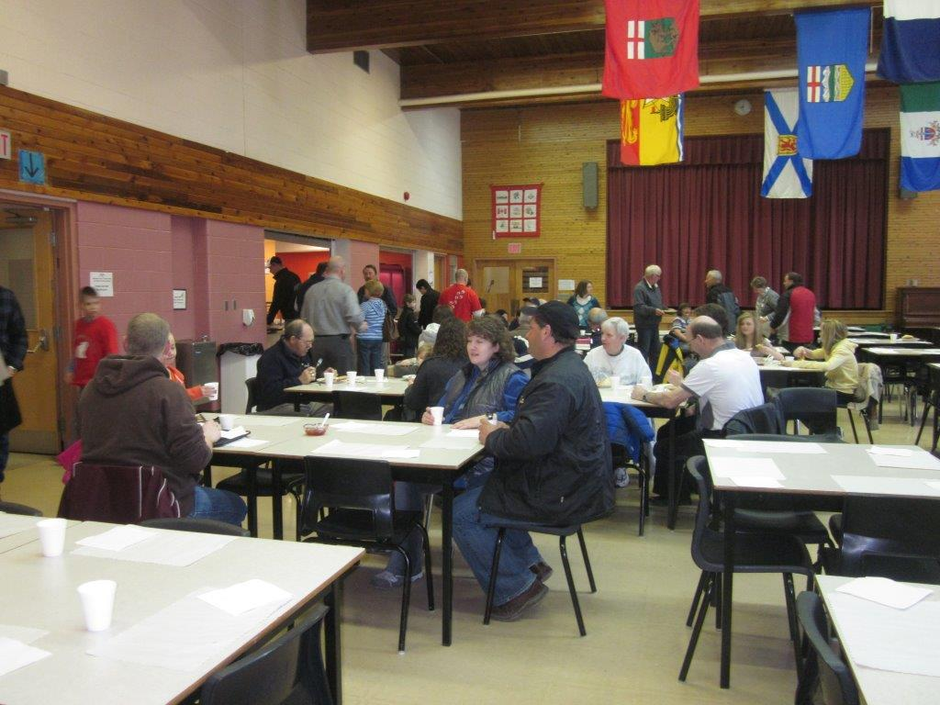
Home and School
$5000 - $10000 each year
I Pad Minis (24) – iTunes cards for each classroom
$2000 – Levelled reading books
8 Christmas Dinners (with support from AV Nackawic) for local families in need
Assist with Grade 5 Farewell
End of the year Splash Party
Notes:
Our Home and School here at NES was re-established in 2010 and currently has 54 families involved. With the proceeds of their many efforts, there has been several gains for NES as you can see listed just a few.
The Home and school has not only focused on our children’s education growth but with AV Nackawic’s assistance have had the ability to help meet the needs of families in the community and continue to unite both our school and the community together.
This illustrating to our children that it is everyone’s duties to give back and support each other!

Slide 7
Impact on Community
Notes:
When we talk about the Impact of our schools on the community, we have to talk about rental space. Within our schools, there are outside organizations that utilize space to offer activities and services to our children and members of our community. I am briefly going to talk about one of them with the permission of River Valley Taekwondo’s owners Stephen and Natasha Kerr.
TKD has been offered at NES since January 2012 and is open to anyone that is 4 Years old and above. They have classes on Tuesday and Thursday evening beginning in September through late May and have people coming in from Nackawic and surrounding areas.
What happens when there is no gym time available to them for rent? Where do they go? Do we lose them completely? We have a couple of individuals and companies that have been able to bring our community their strength and what happens to them if we don’t have the schools to support this? I can tell you this. They will no longer be here.

Slide 8
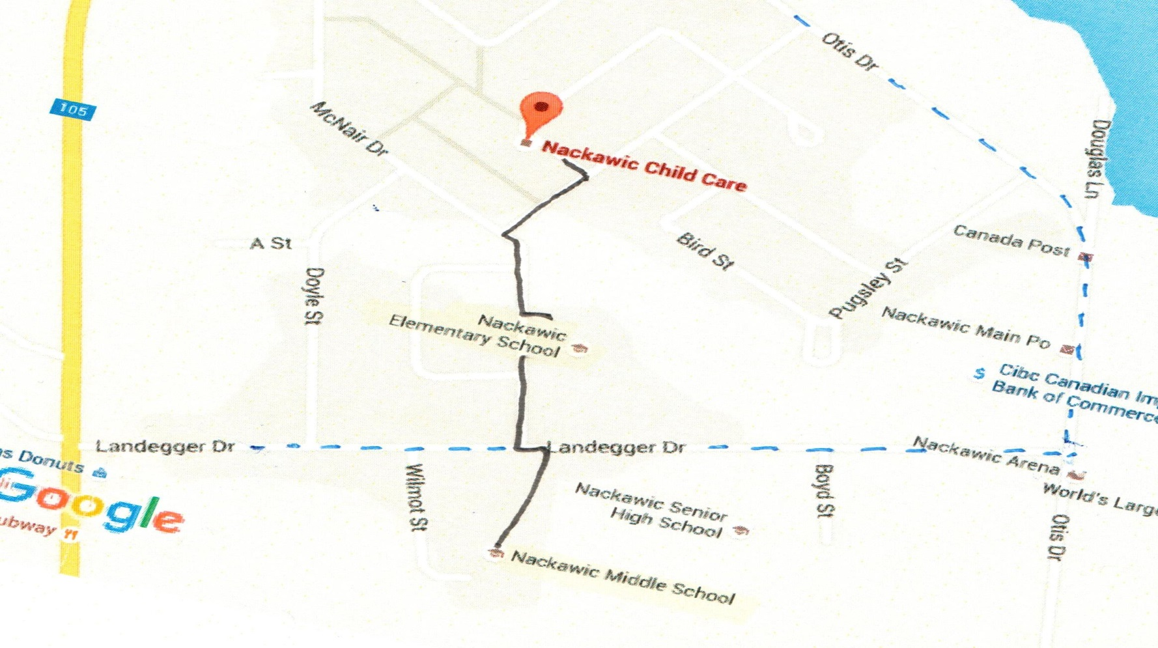
Impact on Community
Notes:
I want to talk a moment about the impact on other children in our community. Our Nackawic Childcare centre uses not only our playground but our public library, and use our gym at NES on occasion.
The great concern, is that the Daycare are walking up to 30 children to the school in the morning. They have one secondary street to cross. If NES was to move to NMS this would double the distance for them to walk with these children as well as have them crossing the busiest street in Nackawic with people going to work, buses arriving, parents dropping children off and high school children driving to school.
This is a major concern especially in the winter; as this road goes downhill and at times is very slippery.

Slide 9
Survey Results- Status Quo
Notes:
Following Meeting #1, the PSSC surveyed the parents to find out what they thought was best for their children. As you can see here, the results were overwhelming.
90% of our parents selected status quo or for repairs to be completed to maintain NES.
In the remainder of my presentation, I will supply you with the data which has helped us make this decision.

Slide 10
Enrolment
(2016 Based on Kindergarten Registration – 29)
Notes:
I would like to start by showing you an improved graph for the projection for next year’s enrolment. Previously presented at meeting #1, a decline in enrolment was anticipated.
Now with the registration of kindergarten students already completed for next year, this number is now 29 with a projection of 31.
This is above the projection of 26 shown at our last meeting, showing our enrollment numbers are increasing.

Slide 11
Impact to Enrolment
AV NACKAWIC
SISSON MINE PROJECT
NB POWER MACTAQUAC DAM
NACKAWIC AREA REFUGEE SUPPORT GROUP
Notes:
I want to now draw your attention to some possible economic opportunities that could have an effect on the future enrolment numbers here in Nackawic. We have three major companies that currently have or will have an effect on this area.
First, is of course AV Nackawic… Which you have heard from tonight.
Second, is the Sisson Mine Project and Third, the Mactaquac Dam – more on those in a moment.
The fourth item you will see is Nackawic Area Refugee Support group… recently the community has formed a group to sponsor and support a refugee family and is in the process of putting forth an application for a family to be moved to Nackawic. This group has not limited itself to just one family and is looking at this as an ongoing process for possibly many years to come.
Although, this is in the beginning stage a strong need is being shown within our province and we, the community and surrounding areas have decided to take an active role.
Although this is a small part of the big picture, I felt it worth being mentioned this evening.

Slide 12
Impact to Enrolment
$579 MILLION
INVESTMENT DURING CONSTRUCTION
300 JOBS
IN NEW BRUNSWICK DURING THE 27 YEAR LIFE OF THE MINE
500 JOBS
DURING CONSTRUCTION
$100 MILLION
ANNUAL OPERATING EXPENDITURES
Jobs = Families
Families = Children
Children = Schools
Notes:
When I reviewed the impact of the Sisson Mine Project, 3 major questions arose and I believe need to be considered carefully:
With looking at the numbers of employment of 300 to 500 jobs, is it realistic to think that there will be a large increase in people moving to the Town of Nackawic and the school catchment area?......... Yes, it is realistic.
Will there be areas of indirect employment that this project will have that could affect our community?.......... Yes, there will be
Will some employees want to come to the closest town compared to living in smaller communities or a larger town or cities? ………..With the services available in Nackawic, yes.
It has been well documented in the company’s reports that there will be a major impact for not only the York county but also Carleton County as well.
As recently as a month and half ago, newspapers have reported that the Sisson Mine project has been given provincial EIA approval and is now ready for its’ next step.
Also after speaking with Greg Davidson, the community relations manager, I know that the roads from Stanley to Nackawic will be utilized and a park and ride will be set up in the Nackawic/Millville area to allow easier access for their employees and the highway system ensuring that the travel between Stanley and Nackawic will be easy and convenient.
These items all need to be considered carefully when we talk about enrolment as well as what our schools will need to look like to be able to accommodate possible future numbers.

Slide 13
Impact to Enrolment
Section 3.2
(Social Impact Comparative Review)
“..for any options, will put an elevated demand on local community infrastructure and services, including emergency services, hospitals, schools, and housing.”
“Workers who relocate to the study area may decide to purchase homes in the nearby communities including Fredericton, Woodstock and Nackawic.”
Option 1 1000-1500 workers
Option 2 600 workers
Option 3 150-300 workers
Notes:
Moving to the third company that may have a major impact on the future enrolment of our schools is the Mactaquac Dam.
In speaking with one of the employees of Dillon Consulting who assisted in completing the Social Impact Comparative Review for NB Power, I learned that the company believes that there will be a huge impact on Nackawic and its surrounding area in whichever one of the three options are selected.
After this conversation, I reached out to NB Power and corresponded with an Environment Manager for the project in which he referenced the Comparative Environmental Review documents, which I have shared the link for at the end of my presentation for your review. It is approximately 500 pages and further outlines that which ever option is chosen there will be an impact for our area as demonstrated on this PowerPoint.
The decision on which option will be made at the end of 2016, but again with whatever option is chosen there will be an impact.

Slide 14
Enrolment
What we do know!
NES 66% Capacity (Current)
Consideration with adding Millville students
75% Capacity
60-80 is considered to be “optimum”
Notes:
Let’s talk about the things we do know….
Based on current enrolment at NES we have 206 children with the capacity of 312. This would tell us that we are at 66 % capacity and if Millville were to close that number would move to 75%. As David has stated at the first public meeting the optimum percentage is 60 – 80%.
I would believe that there is no question that this school needs to remain open. It is situated to handle the impact of the possible economic growth for our area.

Slide 15
Enrolment
What we do know!
Proposed NEW K-8 (with NES and NMS)
81%
Consideration with adding Millville students
90% Capacity
80-100% is considered to be “FULL”
Notes:
As well, we know that a reconfiguration of a K-8 would see an enrolment of approximately 359 students with the building capacity of 442. This making the functional capacity of 81%. If we were again to consider Millville students with this, we would then be at 90%.
To close our school now, we would see our children placed in an environment that would be overwhelmed by the current numbers and in a less than optimal situation.
When these projects begin to roll out, we could see the minimal savings projected with the closing of our school swallowed up quickly with expansions or even new school construction to handle the new enrolment numbers.

Slide 16
Quality Education
Bath K – 8 School
Notes:
After the first meeting, I decided it was imperative to see what a K-8 school looks like and how it works. After speaking about this briefly with David, myself and another PSSC member arranged to visit and get a tour at the newly merged Bath K-8.
As all of you may be aware, there was a decision made by the DEC along with the community of Bath to close the Elementary school and have a K- 8 at what was then Bath Middle School.
I want to begin by saying what an extraordinary and committed staff this school has.

Slide 17
Quality Education
BATH MIDDLE SCHOOL
Proposed K-8
Gym sharing
Loss of Elementary Playground (as of visit)
Library (redevelopment)
Lack of Private Space for students
Art, Music, computer labs etc.. reconfigurations (if they can)
Renovations still needed to accommodate what they NEED/HAD
Notes:
In the tour, I realized that the issues that were happening at Bath would be the same issues in a Nackawic K-8. Except here, they would be increased just based on our enrolment numbers and our growth potential……
We would not have the same educational opportunities and experiences that our schools now provide. Our children’s education would be greatly affected…..
Touring Bath shows that making a consolidation before investing the proper amount of time and money needed to make the right renovations made for a less than optimal environment.
Space was and is an issue. Kids had to share gym time with other classes to get 5 days of gym. With our enrolment, even with shared gym times, it seems impossible that our children would see that much time in the gym.
There was absolutely no space unused in that school, absolutely none! Bathrooms that were just recently installed for the K-2 had a major flaw with the urinals in the boys bathroom installed too high, the correction for this was a built platform for them to use.
To accommodate the educational opportunities that are needed, areas and rooms within their industrial shop were being utilized and worked on to accommodate art, literacy led instruction, home economics and a computer lab with No sound barriers……
How any of these programs are expected to operate and educate effectively is a wonder.
The new library in the old home ec room was not functional with the books in boxes and with no shelves to place them on.
We spend a lot of time working on literacy with our children so to have a non-functioning library within a school seems to be counter- intuitive to the province’s mandate to increase our literacy scores.

Slide 18
Quality Education
#1 Shop
Computer Lab
Literacy Lead
#2 Library
Unfinished Library
#3 Resource
M&R Teacher
Art
Art Supplies
Speech Pathologist
Temp Library
Guidance
Home Ec
Teacher Resource and supply area
Notes:
The staff at the Bath K-8 have done remarkable work in what must seem like impossible conditions.
One of the most concerning areas for me was the shared office on the upper level of the school. This room was shared between the guidance counsellor, the method and resource teacher and with some speech pathologist time when permitted.
So this being said, when a child may need to discuss sensitive issues, they could be interrupted or sharing the space with another child who needs help with extra work or that needed space away from others for a time period.
This is not the model of what is needed to have our children feel like their needs are valued and to give them the ability to discuss things that are important and private to them.
Also, to add to this, this was the space set up as the temporary library for the older kids until the other library was completed and in working order. This area being smaller than our current R&M room at NES!
Unacceptable but in itself would be a reality if one of the “What-If” scenarios were decided from Meeting #1.

Slide 19
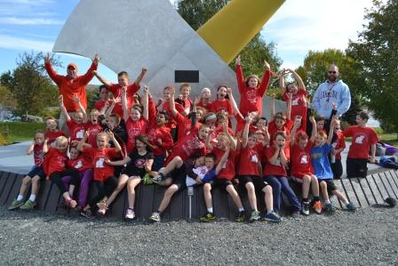
Health and Safety
Mini Girls A Team Basketball (4-5)
Mini Girls B Team Basketball (3-4)
After school Intramurals (3-5)
Jr. NBA Basketball (K-1)
Jr. NBA Basketball (Gr.2)
Gymnastics (K-5)
Taekwondo (K-5)
Drama Camp (3-5)
Drama (K-2)
Violin ( 3-5)
Choir and Jr. Choir (K-5)
Notes:
At NES, we have a full gym designed to meet the needs of all of our children as well as a gymnastic climbing structure. We have a computer lab and full library with age appropriate books. NES has worked very hard at developing extra opportunities to accommodate the development of all of our primary grade children. We begin as soon as they arrive and have increased their opportunities every year as you can see here in this slide. The staff at NES, have been able to allow our primary children the opportunity to have extra curricular activities added to their lives, that teach our children social skills, peer support, the importance of physical health and so much more. Will all of this be available with a consolidated school? Not as it stands. Will we have enough space for two computer labs, not as it stands…. Will there be enough space for our children to continue with the Jr. NBA program and drama programs that are currently offered? Not as it stands… I have been to all three schools on several nights and I can assure you that they are almost in continual use. NMS and NHS share their gyms to give their students the ability to be involved in programs and to allow them the space to practice and continue their growth within their area of interest.
Are we willing to tell our children here at NES that their physical activity is no longer important?
Are we willing to tell them that kids only within a certain skill level are able to enjoy and participate in what they are passionate about?
Are we willing to eliminate programs for our younger children? Only to try to engage them later in life?
We say no – our children deserve the same educational opportunities as other students in this district.

Slide 20
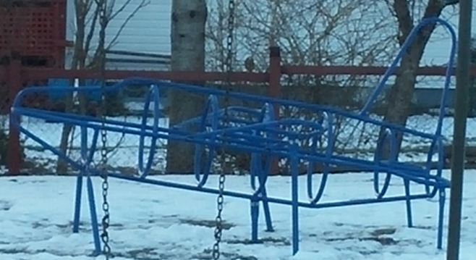
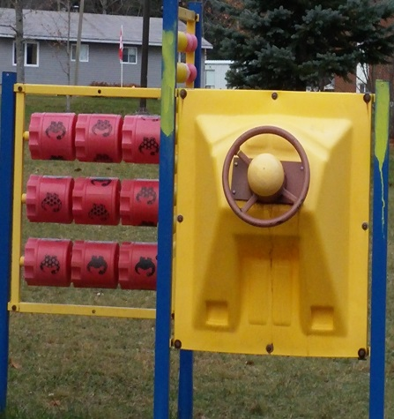
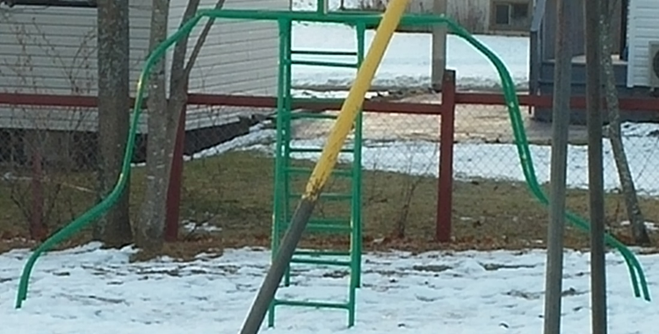
Playground
Notes:
When we look at what our children have at NES, we have to think about the wonderful playground that volunteers and the community have worked so hard on. The ability to have individual space for both the primary grades as well as the older grades. This allows them to develop through the natural stages of growth, development of their social skills as well as giving the teachers the ability to help children develop conflict resolution skills in an appropriate manner and build the foundation for continued growth.
If we were to move to Nackawic Middle School, all of our equipment would not be able to be moved and we would automatically lose one soccer field- two can now barely accommodate our growing programs how can one be expected to handle it?
As you may have read, David has reported that although our equipment meets CSA requirements, the removal and relocation is likely not to happen and that we would need to look at getting new equipment that is not covered with the relocation. This being left to our community. David had mentioned the cost is minimally $80,000 . I have researched this data and can assure you with the requirements set forth by CSA, this is a very conservative number to even replace what we would be leaving behind. The cost would most likely be in the 6 figures. This will have to be funded by fundraising and could take us years to replace. I can assure you that some of our children may never see it back in their time at a new K-8.

Slide 21
Quality Education
Shop Room
Art Room
Music Room
Sewing Room
Home Economic Room
Notes:
Reconfiguring our Schools into a K-8 would definitely see several losses for both our NES AND NMS students.
Of the these 5 areas of education that you see on the slide, we would need to remove at least 3 if the school was to function as is just to accommodate the needed home rooms.
If approval was given to add a portable, we would still lose at least 2.
This still would mean limited gym time, a cafeteria that would be too small to handle the increase in students, all the offerings that I have talked about tonight at NES and only one computer lab for over 350 students.

Slide 22
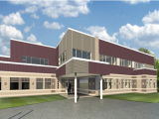
Quality Education
Townsview School
New School Development in our District
Meduxnekeag Consolidated School
Notes:
Let take a quick look at some other schools recently opened in our district.
When looking at the two new Woodstock schools that have recently been built and opened in Woodstock, you see a very different understanding of what school and the educational opportunities offered to students a mere 50 kms away looks like.
Large spacious classrooms, primary classes have bathrooms in them, the latest technology with newest smart boards and projectors, cafetorium that has a stage with all the lights and sound built in as well as back stage, giant art room with built in cupboards, a music room and a mini theater with built in risers, 2 gyms with offices and large equipment rooms, science lab with a storage room for chemicals, shop area and tech lab, beautiful library, computer labs, offices for guidance, resource and specialists. They even have an area for a pre-school system which they are working on setting up this year and had money to spend for all new materials.
Seeing such a space, you know that the children who attend these schools are going to have a wonderful environment to allow their curious and active minds to explore and learn in.
I regretfully say that this is not what is in the works for Nackawic on the “What-If” scenario.
I believe that the creation of a K-8 in Nackawic will see what can only be labelled as a two tiered educational system in our district. That what was not acceptable in the creation of the new schools in Woodstock will be more than happily thrust on our children and deemed more than appropriate and acceptable.
The effects of a two tiered educational system would be detrimental to the quality of our children’s education and futures and is unjust.
This is not acceptable.

Slide 23
Health and Safety
As adults, we are equipped to manage and reduce the stress in our lives, but what about our kids? They can feel stress like we do, but they don’t always know how to deal with it.
Notes:
The savings that were presented at the first meeting that would be seen from a reconfiguration are minimal but come at a great cost to our children and their education.
Our teachers because they are so committed, would see that the children were taught but… I am sure that morale would be low as the challenges and obstacles are worked through.
Our children and their future deserve better than to be used as a cost saving measure.

Slide 24
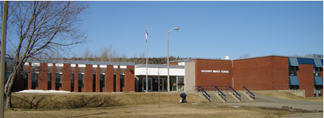
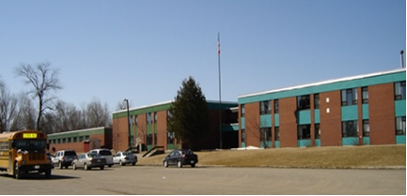
Quality Education
Notes:
According to the District’s own definition Nackawic Elementary is at the optimum capacity for the educational needs of its students.
Why, would we then close it to put our children into a less than optimal situation?
What we have is currently serving our children and their needs well, to make any changes would be destructive to our children, and this is simply irresponsible and wrong.
Ttake into consideration the information presented here tonight.
Reflect strongly on what it would mean to close our schools then be forced into an unsound situation if Nackawic sees a surge in population growth as predicted.
Please leave the status quo here in Nackawic for the sake of our children and their futures.

Slide 25
Nackawic Elementary School
What we do know!
NES 66% Capacity (Current)
Consideration with adding Millville students
75% Capacity
60-80 is considered to be “optimum”
Notes:
In closing a final note….
To the DEC Members who are faced with making a very hard decision, I ask that when you recall my presentation you take at least this one thought with you….
We are a community that has the potential for growth given the large industrial projects on the horizon. We have strong community involvement and support and are confident that we have made the right choice in our request to maintain status quo.
Thank you

Slide 26
Resources
http://www.sissonpartnership.com/s/opportunites.asp#R660903
http://www.mactaquac.ca/wp-content/uploads/2015/09/SICR_Mactaquac_Project_Sept2015.pdf
http://www.mactaquac.ca/wp-content/uploads/2015/10/CER_Mactaquac_Project_Sept2015.pdf
http://www.cbc.ca/news/canada/new-brunswick/sisosn-mine-eia-approval-1.3348552

